Slide 1





PRODUCT DESIGN AND RETAILING
Little Friends
Team 3 : FURFLEX (Financial Service)
Jasmine, Moxi, Joshika, Likhitha
Team 5 : The Conscious Collective (Retail; non-food)
Aweni, Akil, Mingwei, Wenxuan, Yijun

Slide 2
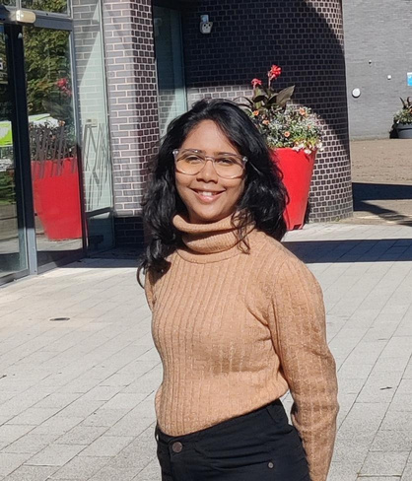
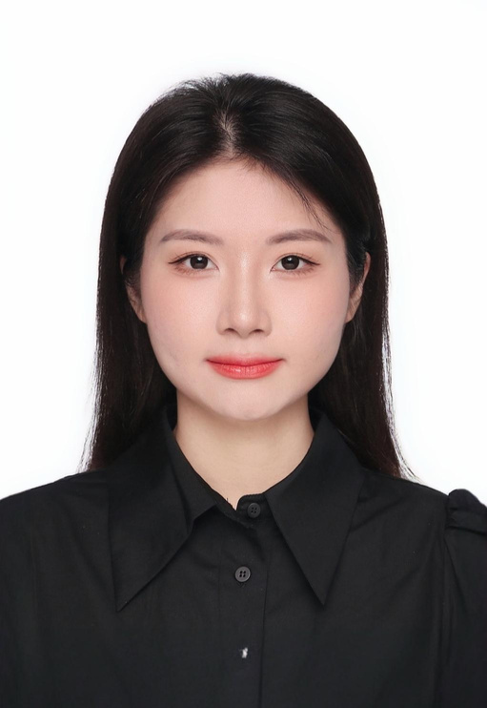

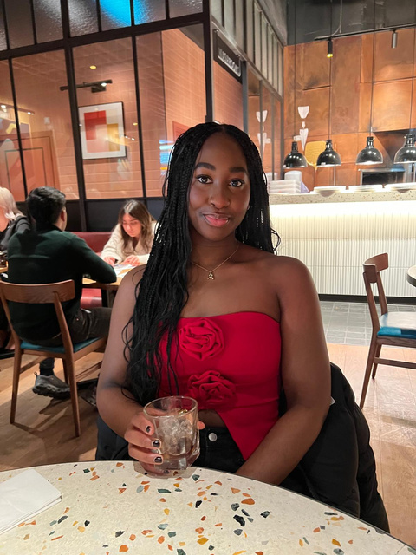


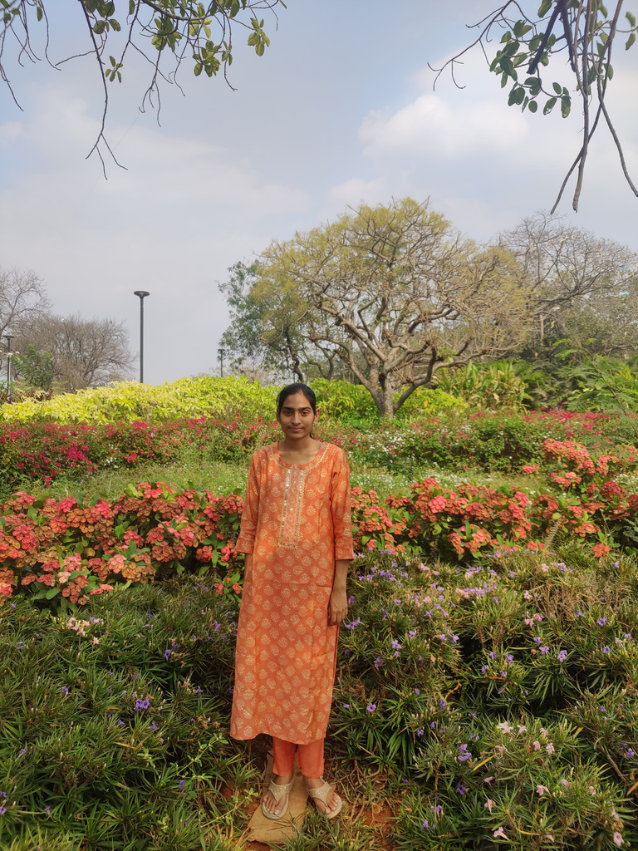

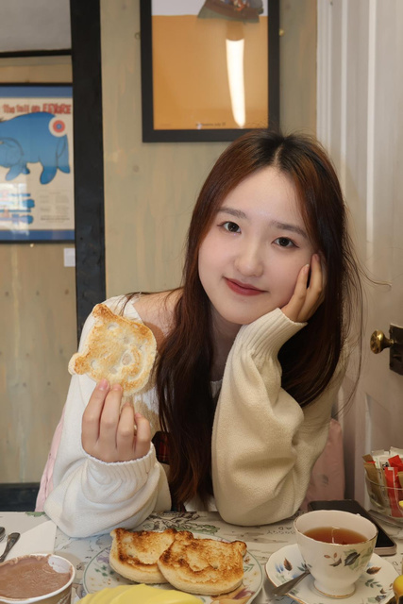
LITTLE FRIENDS
Meet Our Team
FurFlex
The Conscious Collective
Joshika
Jas
Moxi
Aweni
Mingwei
Wenxuan
Likhitha
Akil
Yijun

Slide 3


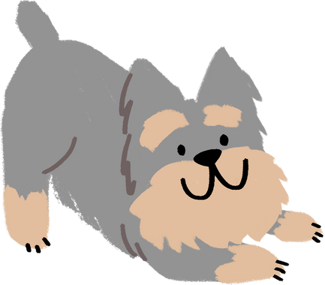
LITTLE FRIENDS
Form of Collaboration: Joint Venture
Investment of Resources
Product Design
Financial knowledge
Retail knowledge
Raw materials
Partnership network
Fur treatment
Management and Operation Structure
Product develop Department
Brand Building Department
Marketing Department
Financial Department
Raw materials Department
Quality Control Department
Ownership Structure
60%
40%
The Conscious Collective (Retail; non-food)
FURFLEX (Financial Service)

Slide 4
LITTLE FRIENDS
Objectives Achievement Analysis
Innovatively combine the capabilities of both sides to develop new product
Establish a Common and Unique brand identity
Enter new business sector
Retailing : sustainable clothes
Retailing : sustainable clothes
Raw material resource (sustainable)
Designers
Partnership networking
Little Friends
Finance Service: pet insurance, pet Healthcare
Market Potential:
75% of British consumers are willing to pay a premium for
eco-friendly products (YouGov, 2023).
Pet owners spend an average of £1,500 per pet each year, with
£200 of that on eco-friendly products (PFMA, 2023).
Competitive Advantage:
Competitors:
Scruffy Tails, Pet Keepsakes UK, EcoPaw
→We have extensive channels for collecting raw
materials
→We have a more diverse product line
Product design & Retailing
Pet Product Design:
beds,pats, tools, blankets....
Raw Material:
① dogs, cats, rabbits,
old feather Bedding...
② sustainable materials
Sourcing manufacturers → Products → Pet owners & Stores (Pet)
Channels: exist websites
Finance Service: pet insurance, pet Healthcare
Raw material resource: (Furs)
Financial knowledge
Fur quality control

Slide 5

YIJUN & JAS.
Profit Model
Pet Fur Products Sales
Sale pet fur products
such as toys, brushes, blankets, etc)
Peripheral Products Sales
· Products with our brand's logos
· Customised pet products
Provide membership services such as exclusive discounts, customised products, free product trials
Subscription fees (monthly/annual)
Paid Membership System

Slide 6

Estimated Total Profit：
£166，000
YIJUN & JAS.
Profit Estimation
Business Segment | Estimated sales | Estimated price | Profit Rate | Net Profit
Pet Fur Products Sales | 10,000 | £15/unit | 70% | £105,000
Peripheral Products Sales | 1500 | £50/unit | 60% | £45,000
Paid Membership System | 2,000 | £8/year | 100% | £16,000

Slide 7

YIJUN & JAS.
40%：60%
Profit Distribution
Business Segment | Furflex | Conscious Collective
Pet Fur Products Sales | 40% | 60%
Peripheral Products Sales | 40% | 60%
Paid Membership Fees | 50% | 50%

Slide 8
LITTLE FRIENDS
Keely’s 10 types of innovation:
Networking | Profit-Model | Structure | Brand
Collaboration: Joint Venture | Diversification of revenue streams | Outsourcing | Brand Extension
Supply Chain Integration | Subscription services | Integration of knowledge and skills | Transparency

Slide 9


Skills from Conscious Collective
Skills | Details
Design skills | Product design
Technical Support | Website design, Website operation（Online customer service, after-sales service）
Marketing skills | Publicity of the product
Marketing skills | Collaboration with influencer
Ethical knowledge | Application of ethical knowledge
Legal support | Legal staff
Supply Chain & Procurement Skills | Manufacturer Selection
Supply Chain & Procurement Skills | Co-operation with raw material（fabric）suppliers

Slide 10

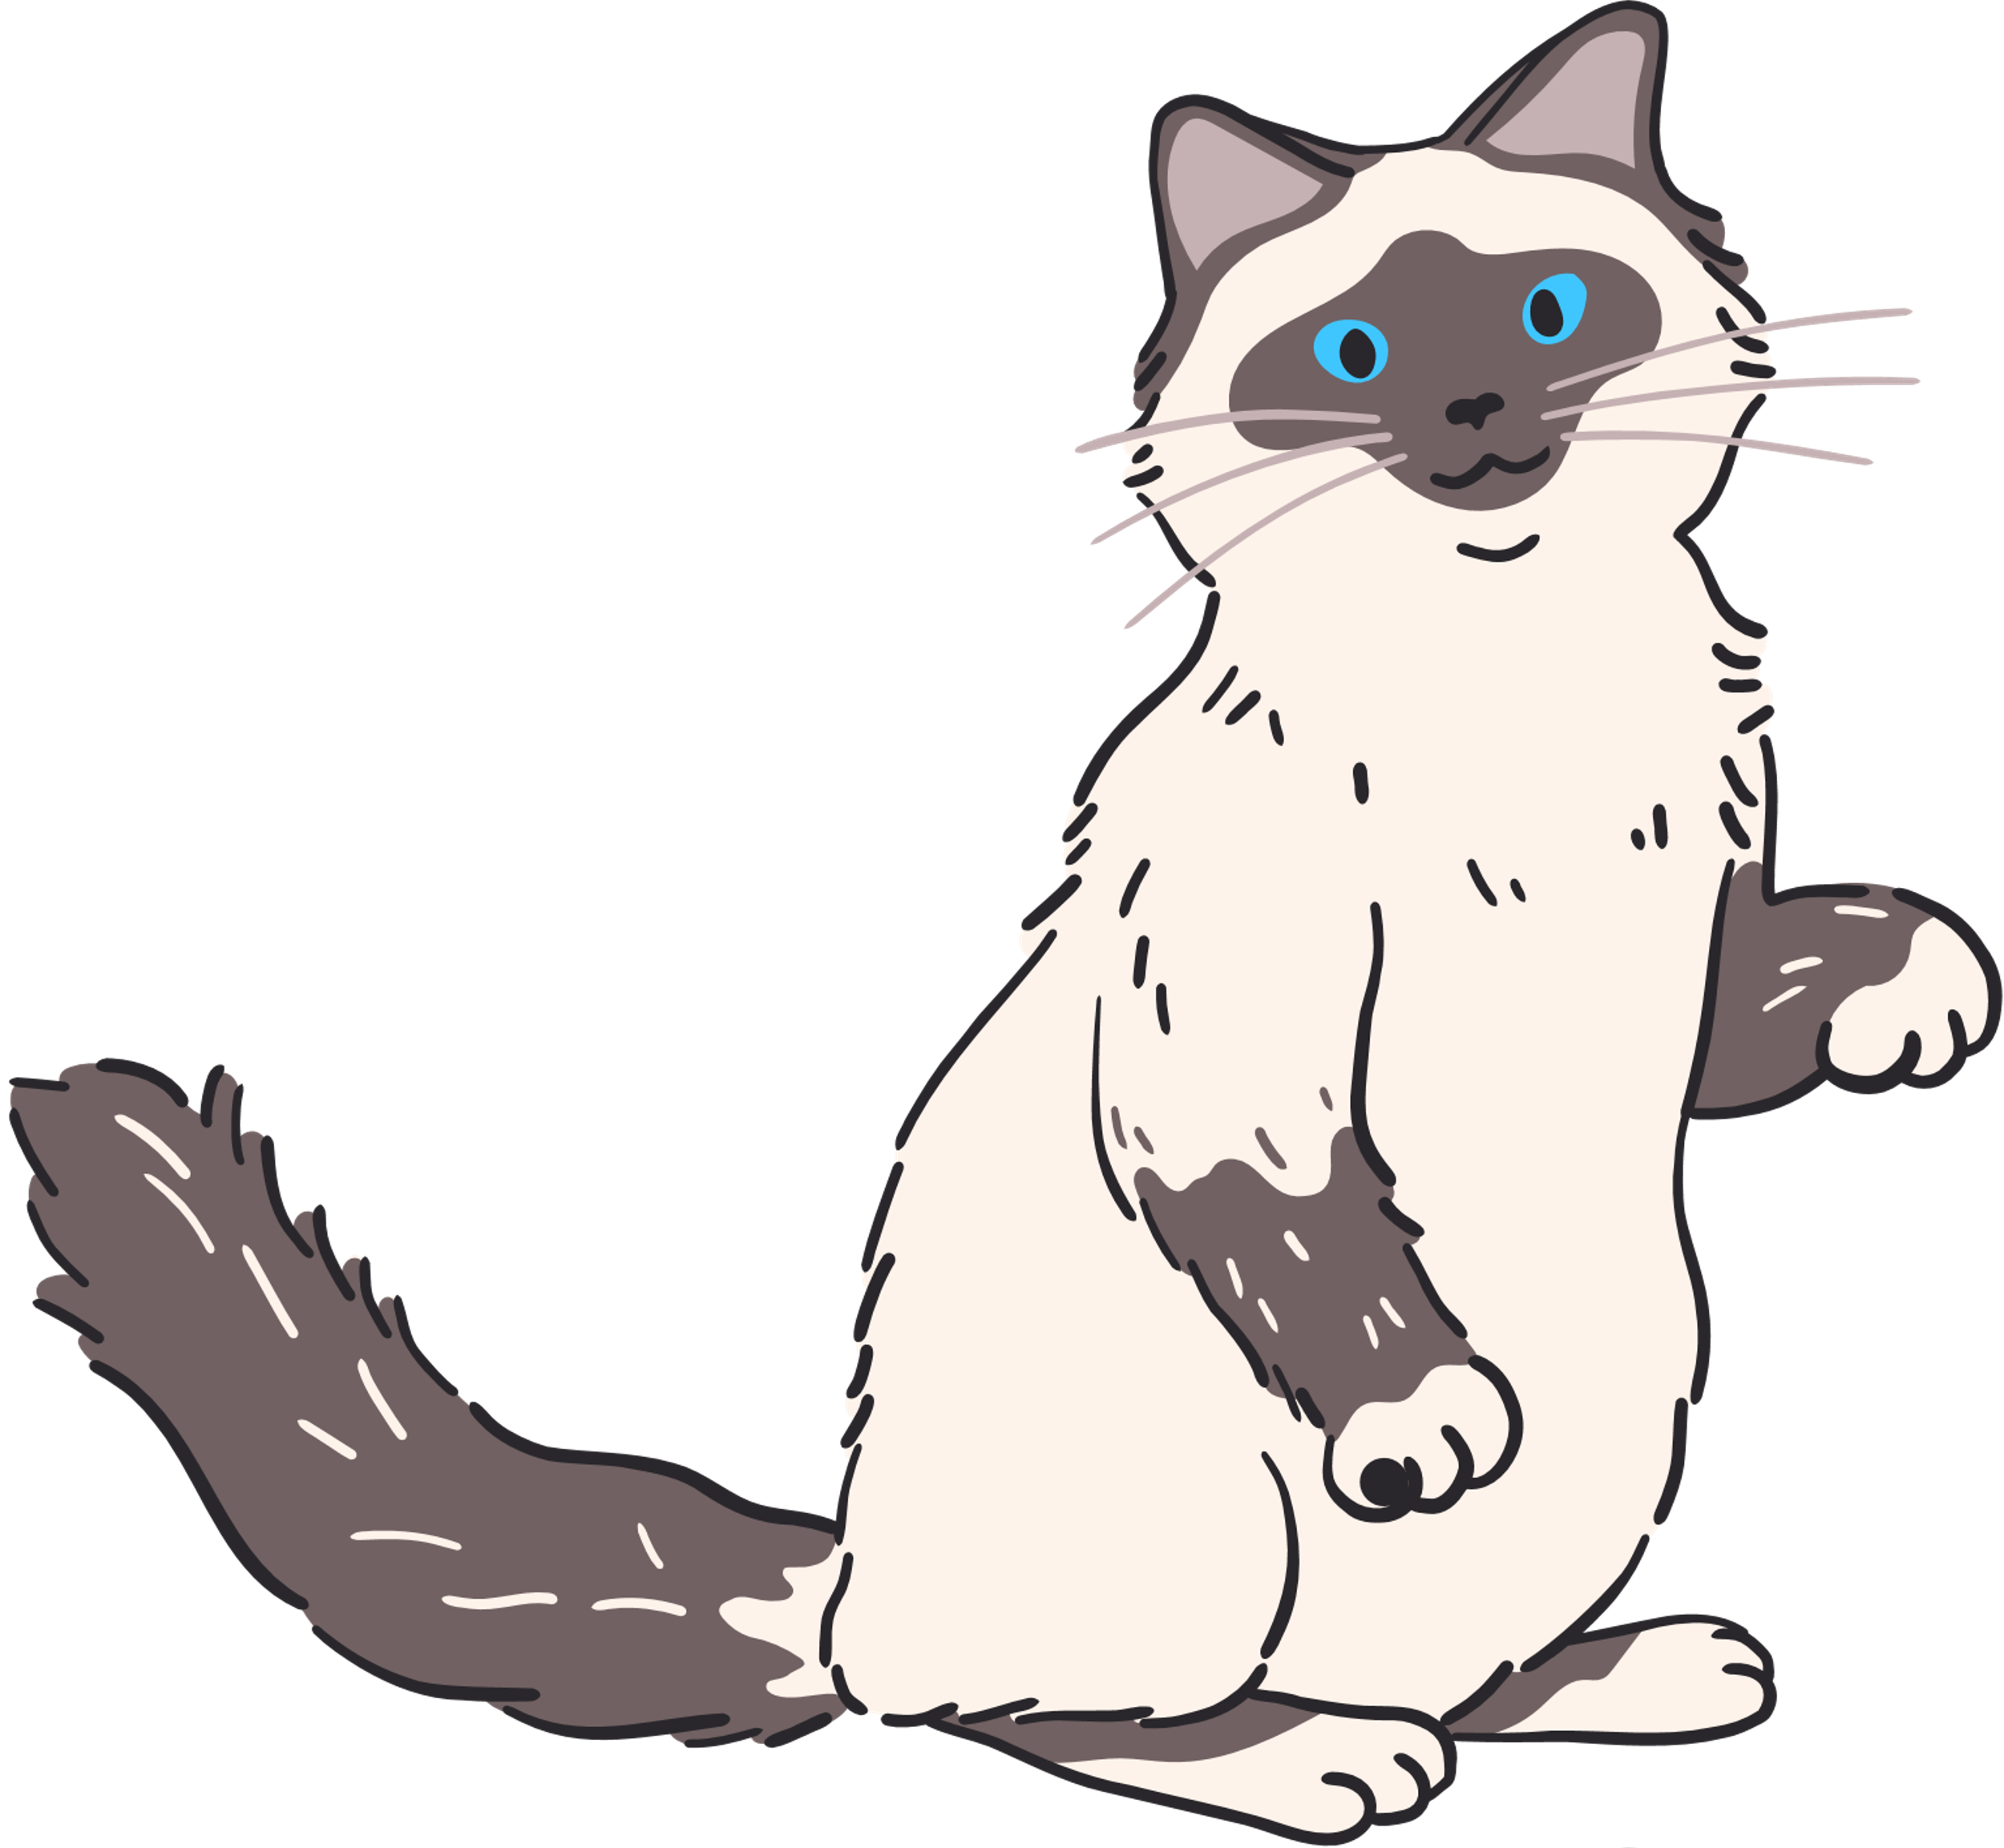
Skills from Furflex
Category | Skills & Capabilities
Technology & Platform Management | Creating a user-friendly website for insurance quotes & pet product sales.
Sustainable Product Sales | Selling eco-friendly pet products (mats, toys) alongside insurance.
Fur Collection & Sourcing | Partnerships with Vets & Groomers: Collaborating with pet hospitals, groomers, and shelters for referrals.
Market knowledge of pet owner needs | useful in helping design products that are practical, safe, and desirable.
Customer Engagement and Communication | Ability to promote the new products through FurFlex’s existing customer base (emails, social media, website

Slide 11






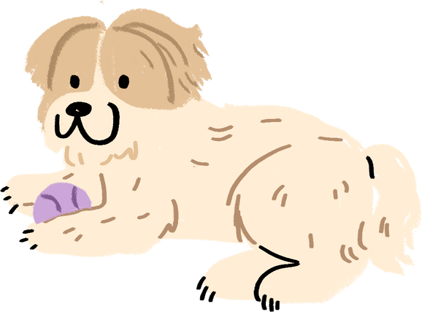

LITTLE FRIENDS
Strategic Gains for Furflex
New Revenue Stream from Pet Products
Make Use of Free and relatively cheaper
Resources
Strengthen Relationships with Vets, pet owners, Groomers
Attract More Customers Through Sustainability
Increase Brand Value
as a Pet Care
Leader

Slide 12
LITTLE FRIENDS
Strategic Gains for Conscious Collective
Expand into the Pet Product
Market
Maximize Use of Existing Materials and Skills
Develop Exclusive
Product
Designs with High
Market Demand
Build Our Brand as a Leader in
Sustainability

Slide 13
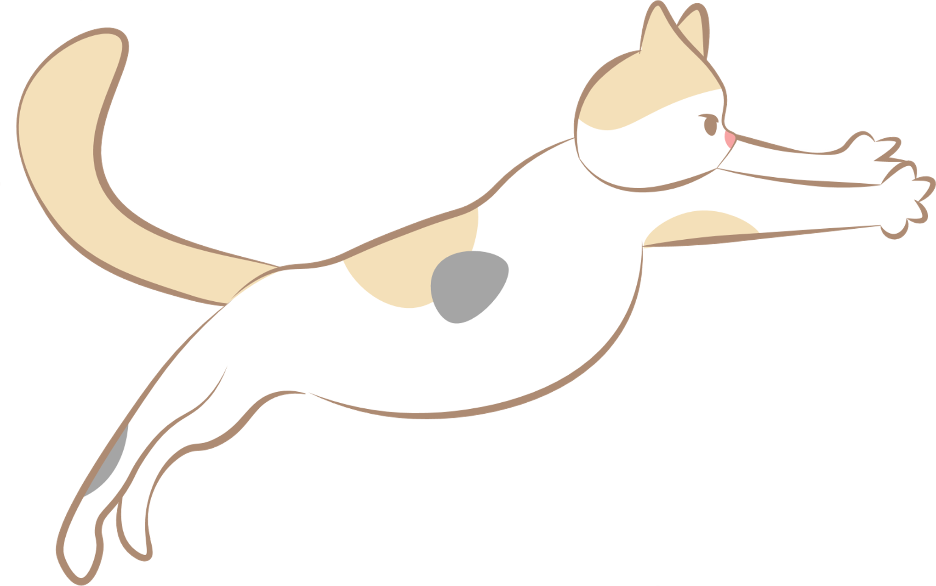

RISKS EACH PARTY WILL ABSORB:
THE CONSCIOUS COLLECTIVE | FURFLEX
Our designs might get copied leading to legal risks | Partnership Risks
Supply chain risk | Inconsistent fur quality
Production delays from manufacturer | Production delays from manufacturer
Scalability Concerns | Inability to collect enough fur

Slide 14
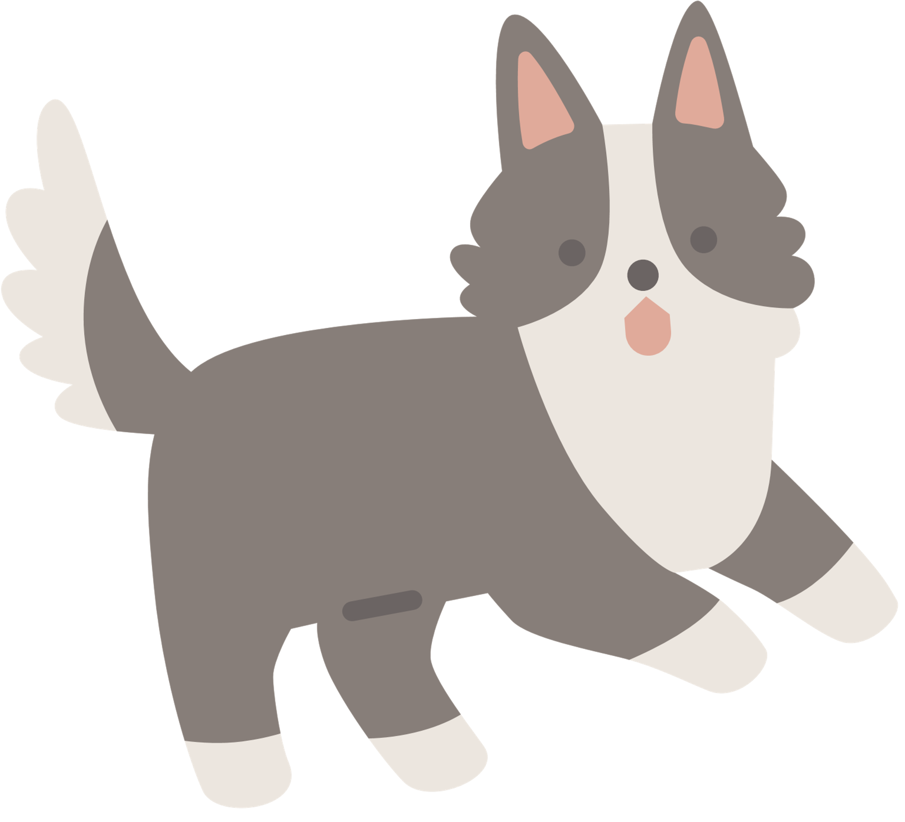
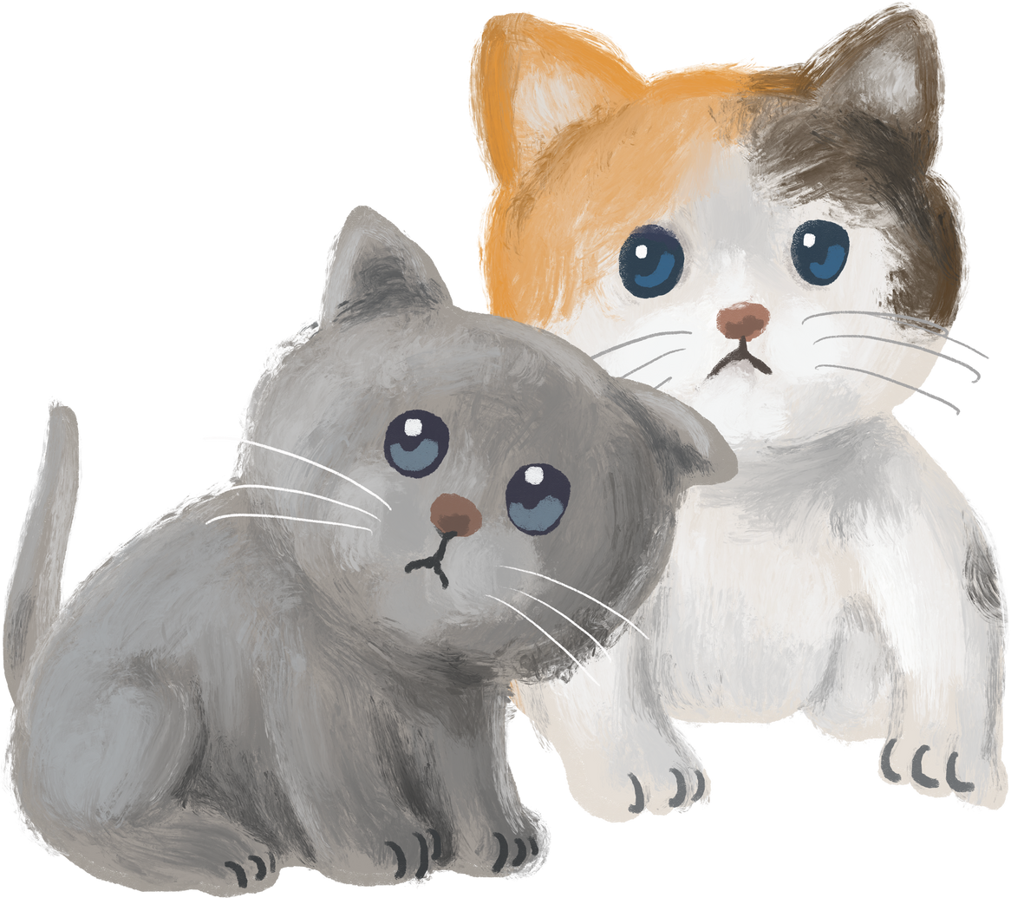
LITTLE FRIENDS
Thank You
Our ask is 50,000​

